Slide 1



Bayesian Graphical Modeling
Context
What is psychometrics? 2024
m.marsman@uva.nl
bayesiangraphicalmodeling.com

Slide 2

Session setup
Part I: History
image: Flaticon.com

Slide 3

Session setup
Part I: History
Part II: Theory
image: Flaticon.com

Slide 4

Session setup
Part I: History
Part II: Theory
Part III: Tutorial
image: Flaticon.com

Slide 5


Session setup
Part I: History
Part II: Theory
Part III: Tutorial
Part IV: Practical
image: Flaticon.com

Slide 6
Session setup
Part I: History
image: Flaticon.com

Slide 7

History (What is network psychometrics?)
X
X
θ
X
Network modeling in psychology
X
X
X
Network models in psychology
Network analysis in psychology

Slide 8
History (What is network psychometrics?)
X
X
θ
X
Network modeling in psychology
X
X
X
Network models in psychology
Network analysis in psychology

Slide 9
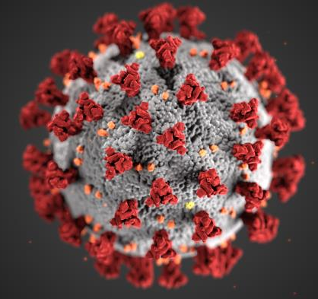
Latent variable model vs network model
Disease analogy
X₁
θ
X₂
X₃
Latent variable model

Slide 10
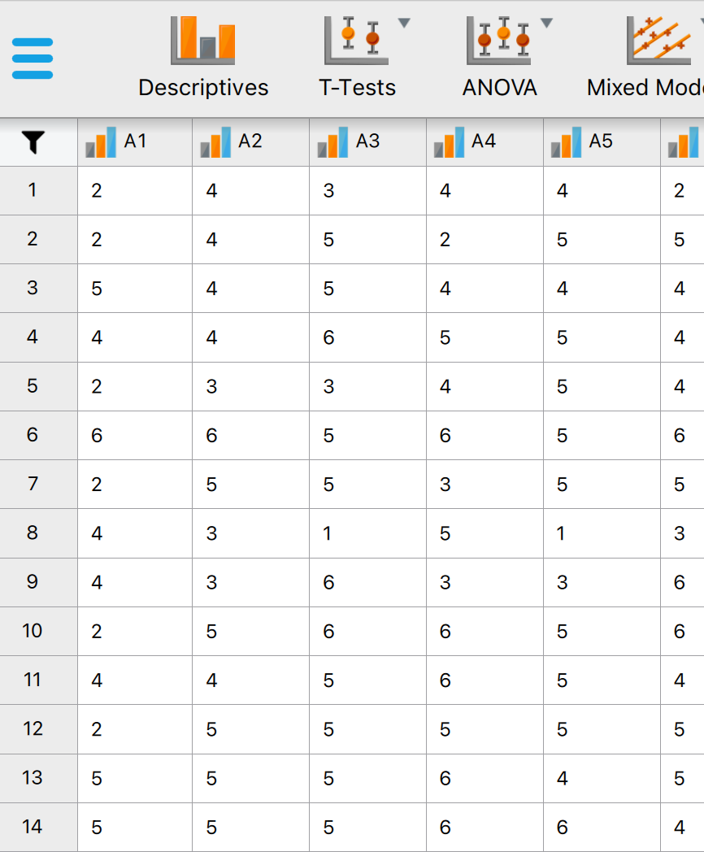
Latent variable model vs network model
Disease analogy
Psychological data
X₁
θ
X₂
No conclusive evidence for single cause
X₃
Latent variable model

Slide 11
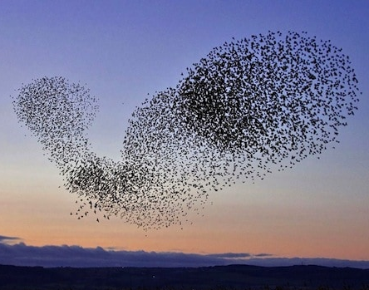
Latent variable model vs network model
Disease analogy
Psychological data
Flocking analogy
X₁
X₂
θ
X₂
No conclusive evidence for single cause
X₁
X₃
X₃
Latent variable model
Network model

Slide 12
Distinct theory, but equivalent statistical models
X₂
X₁
X₁
θ
X₂
X₃
X₃

Slide 13
Distinct theory, but equivalent statistical models
X₂
X₁
X₁
θ
X₂
X₃
X₃
correlation does not imply causation
model fit alone is insufficient to explain the data generating mechanism

Slide 14
Further reading
Marsman, M., Borsboom, D., Kruis, J., Epskamp, S., van Bork, R., Waldorp, L., van der Maas, H. & Maris, G. (2018). An introduction to network psychometrics: Relating Ising network models to item response theory models. Multivariate Behavioral Research, 53, 15-35.
Marsman, M., & Rhemtulla, M. (2022). Guest Editors’ introduction to the special issue “Network Psychometrics in Action”: Methodological innovations inspired by empirical problems. Psychometrika, 87, 1-11.
Waldorp, L. J., & Marsman, M. (2022). Relations between networks, regression, partial correlation, and latent variable models. Multivariate Behavioral Research, 57, 994-1006.

Slide 15
History (What is network psychometrics?)
X
X
θ
X
Network modeling in psychology
X
X
X
Network models in psychology
Network analysis in psychology

Slide 16
History (What is network psychometrics?)
X
X
θ
X
Network modeling in psychology
X
X
X
Network models in psychology
Network analysis in psychology

Slide 17
History (What is network psychometrics?)
X
X
θ
X
Network modeling in psychology
X
X
X
Network models in psychology
Network analysis in psychology

Slide 18
Two distinct research designs (and models)
Cross-sectional
Longitudinal
X₂
X₁
X₂
X₃
X₁
Y₁
Y₂
Y₃
X₃

Slide 19
Two distinct research designs (and models)
Cross-sectional
Longitudinal
X₂
X₁
X₂
X₃
X₁
Y₁
Y₂
Y₃
X₃
Type of Variable | Model
Binary | Ising model
Continuous | Gaussian graphical model
Mixed | Mixed graphical model

Slide 20
Two distinct research designs (and models)
Cross-sectional
Longitudinal
X₂
X₁
X₂
X₃
X₁
Y₁
Y₂
Y₃
X₃
Type of Variable | Model
Binary | Ising model
Continuous | Gaussian graphical model
Mixed | Mixed graphical model
Ordinal | Ordinal Markov random field

Slide 21
Two distinct research designs (and models)
Cross-sectional
Longitudinal
X₂
X₁
X₂
X₃
X₁
Y₁
Y₂
Y₃
X₃
Type of Variable | Model
Continuous | (Multilevel) vector autoregressive model, (random-intercepts) cross-lagged panel model
mixed | mgm (n=1)
Type of Variable | Model
Binary | Ising model
Continuous | Gaussian graphical model
Mixed | Mixed graphical model
Ordinal | Ordinal Markov random field

Slide 22
Two distinct research designs (and models)
Cross-sectional
Longitudinal
X₂
X₁
X₂
X₃
X₁
Y₁
Y₂
Y₃
X₃
Type of Variable | Model
Continuous | (Multilevel) vector autoregressive model, (random-intercepts) cross-lagged panel model
mixed | mgm (n=1)
RELATED | TV-Var, (ml)HMM, Gimme, continuous time models
Type of Variable | Model
Binary | Ising model
Continuous | Gaussian graphical model
Mixed | Mixed graphical model
Ordinal | Ordinal Markov random field

Slide 23
Ordinal Markov random Field

Slide 24
Ordinal Markov random Field
emotional
problems
time
spent
work
problems
tolerance
dangerous
activities
setting
limits

Slide 25
Ordinal Markov random Field
emotional
problems
time
spent
work
problems
tolerance
dangerous
activities
setting
limits

Slide 26
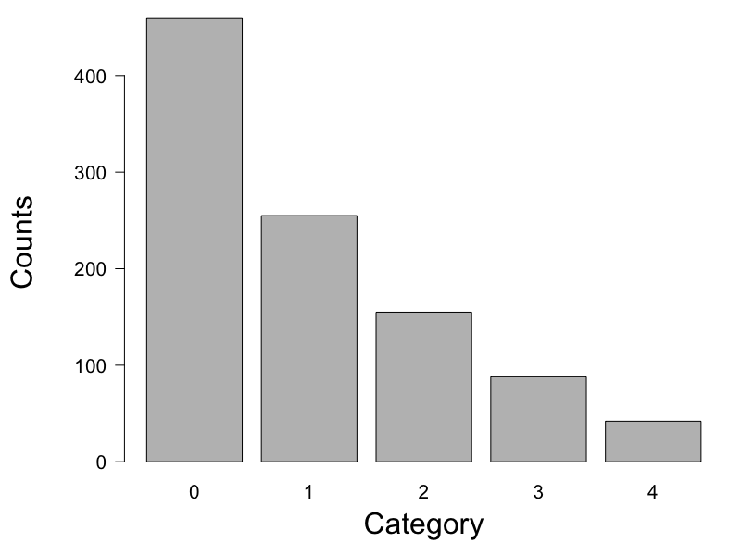
Ordinal Markov random Field
emotional
problems
time
spent
work
problems
tolerance
dangerous
activities
setting
limits

Slide 27
Ordinal Markov random Field
emotional
problems
time
spent
work
problems
tolerance
dangerous
activities
setting
limits

Slide 28
Further reading
Epskamp, S., Haslbeck, J., Isvoranu, A.-M., & van Borkulo, C. (2022). Pairwise Markov random fields. In A.-M. Isvoranu, S. Epskamp, L. Waldorp, & D. Borsboom (Eds.), Network Psychometrics with R. Routledge.
Haslbeck, J., Ryan, O., van der Maas, H., & Waldorp, L. (2022). Modeling change in networks. In A.-M. Isvoranu, S. Epskamp, L. Waldorp, & D. Borsboom (Eds.), Network Psychometrics with R. Routledge.
Marsman, M., van den Bergh, D., & Haslbeck, J. (in press). Bayesian analysis of the ordinal Markov random field. Psychometrika.

Slide 29
History (What is network psychometrics?)
X
X
θ
X
Network modeling in psychology
X
X
X
Network models in psychology
Network analysis in psychology

Slide 30
History (What is network psychometrics?)
X
X
θ
X
Network modeling in psychology
X
X
X
Network models in psychology
Network analysis in psychology

Slide 31
History (What is network psychometrics?)
X
X
θ
X
Network modeling in psychology
X
X
X
Network models in psychology
Network analysis in psychology

Slide 32
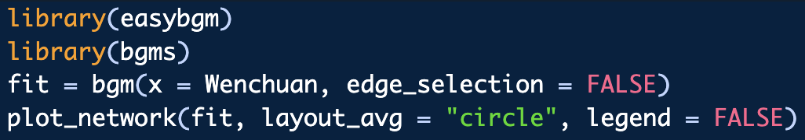
Network estimation
Available methods
Frequentist
Semi-Bayesian (i.e., regularization)
Bayesian

Slide 33
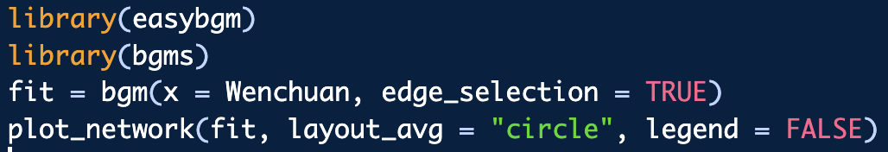
Model Selection
Available methods
Frequentist (i.e., AIC, BIC, etc.)
Semi-Bayesian (empirical Bayes)
Bayesian (Bayes factor)

Slide 34
Model Selection
Testing
Cross-Sectional: Conditional independence
Longitudinal: Granger causality
Available methods
Frequentist (i.e., AIC, BIC, etc.)
Semi-Bayesian (empirical Bayes)
Bayesian (Bayes factor)

Slide 35
Edge configuration uncertainty is huge!
sleep
prob.
concen-
tration
prob.
loss of
interest
tired-
ness
psycho-
motor
prob.
suicidal
ideation
loss of
appetite
reduced
selfworth
depr.
mood

Slide 36
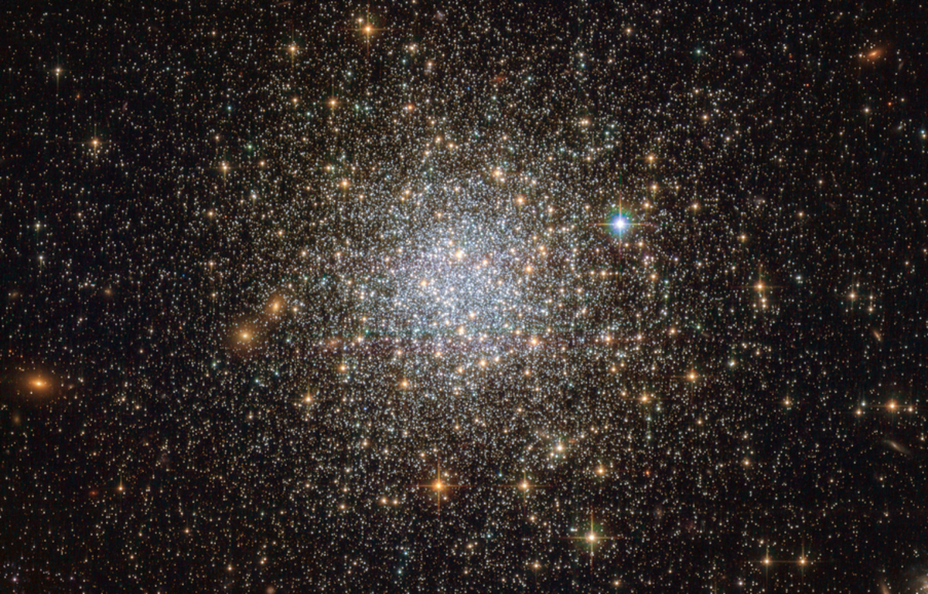
Edge configuration uncertainty is huge!
sleep
prob.
concen-
tration
prob.
loss of
interest
tired-
ness
psycho-
motor
prob.
suicidal
ideation
loss of
appetite
reduced
selfworth
depr.
mood

Slide 37
Edge configuration uncertainty is huge!
sleep
prob.
concen-
tration
prob.
loss of
interest
tired-
ness
psycho-
motor
prob.
suicidal
ideation
loss of
appetite
reduced
selfworth
depr.
mood

Slide 38

Edge configuration uncertainty is huge!
Personal conviction:
Model selection in network psychometrics is useless.

Slide 39
Further reading
Blanken, T., Isvoranu, A.-M., & Epskamp, S. (2022). Estimating network structures using model selection. In A.-M. Isvoranu, S. Epskamp, L. Waldorp, & D. Borsboom (Eds.), Network Psychometrics with R. Routledge.
Oravecz, Z., & Vandekerckhove, J. (in press). Quantifying Evidence for—and against—Granger Causality with Bayes Factors. Multivariate Behavioral Research.
Sekulovski, N., Keetelaar, S., Huth, K., Wagenmakers, E.-J., van Bork, R., van den Bergh, D., & Marsman, M. (in press). Testing conditional independence in psychometric networks: An analysis of three Bayesian methods. Multivariate Behavioral Research.
Williams, D., Rhemtulla, M., Wysocki, A., & Rast, P. (2019). On nonregularized estimation of psychological networks. Multivariate Behavioral Research, 54, 719–750.

Slide 40

End of Part I
Part I: History
Part II: Theory
image: Flaticon.com

Slide 41
Intermezzo
Open R and run the following code:
library(ltm)
#?WIRS
data <- as.matrix(WIRS)
library(IsingFit)
m1 <- IsingFit(data, family='binomial', plot=FALSE)
library(qgraph)
qgraph(m1$weiadj,fade = FALSE)
Describe what you see;
Why is there an edge missing between item 2 and item 3?

